Slide 1
VA COVID-19 screening tool
From email to shipping product in 12 calendar days!
Martha Wilkes
June 2020

Slide 2
Day 1: Friday, May 8 Email arrives from Durham VA Medical Center
“Covid ideas” inbox
Chief of Staff’s son (recent college grad) created a screening tool
Going to start using it on Monday
Could/should DEPO help roll it out nationwide?
Team assembled (Patrick, Mike, Michelle, Danielle, Jeff, Stephen@VA, me)
Since I’m in Chapel Hill, I volunteer to observe first-hand

Slide 3
Day 2: Saturday, May 9 First brief field visit: “before” state

Slide 4
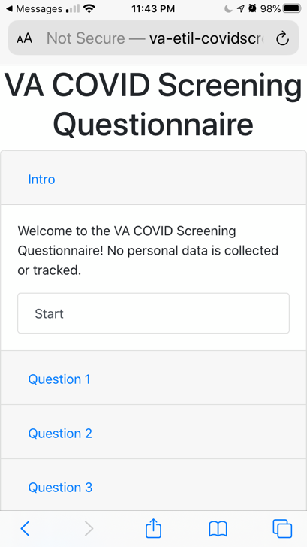
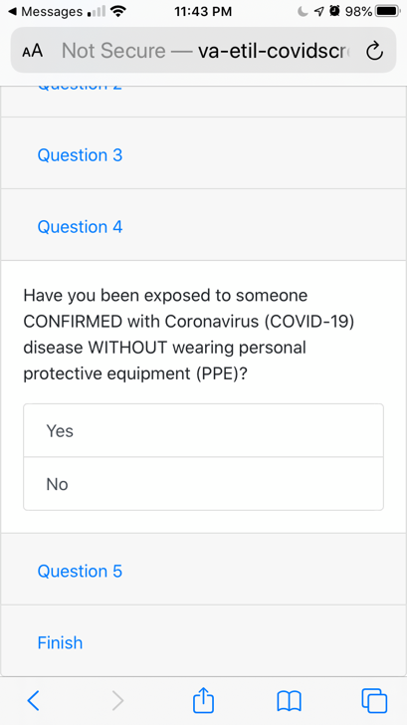
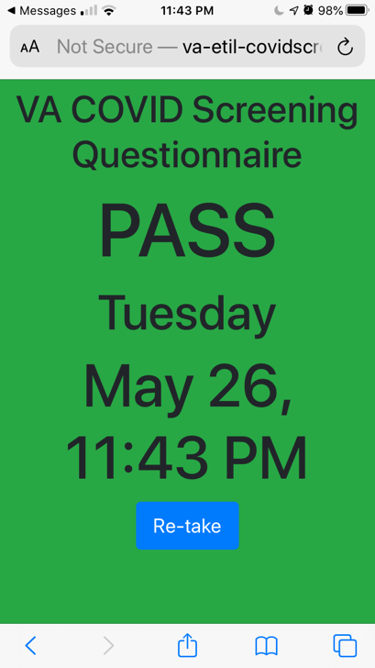
Day 2: Saturday, May 9 First brief field visit
Kim the pulmonology therapist
Showed me her phone

Slide 5
Day 4: Monday, May 11 Second field visit
Day One of ScreenPass operations
Stacy the screener asks everyone questions
Round dot stickers

Slide 6
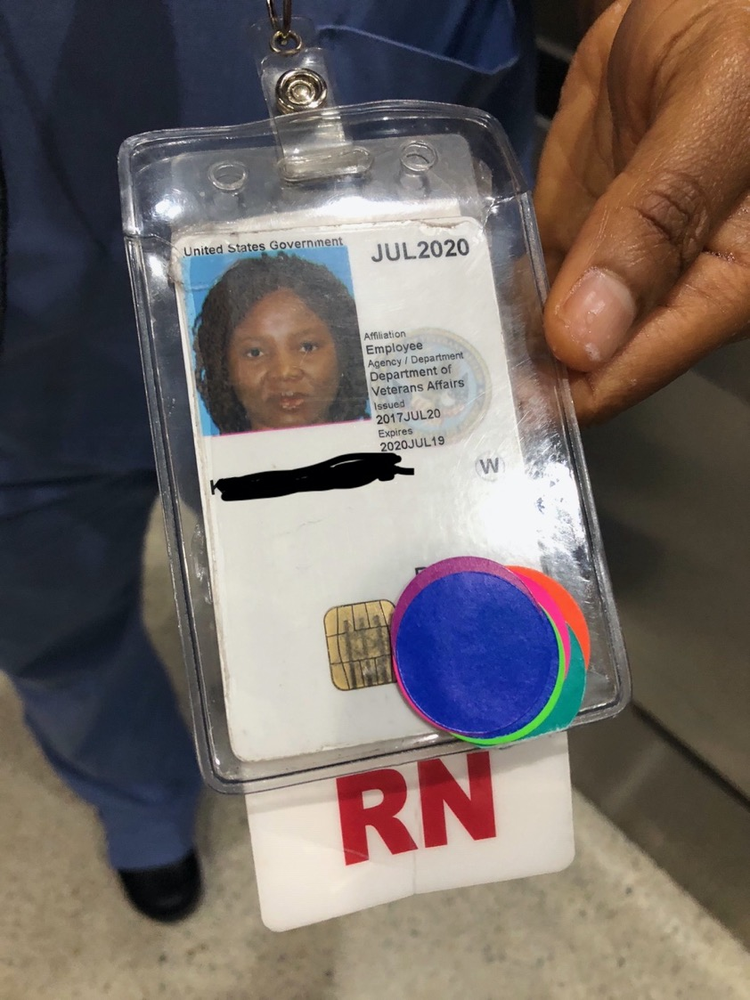
Day 4: Monday, May 11 Second field visit
Employees have a rainbow of stickers
Met with Durham stakeholders
“National” visitor

Slide 7
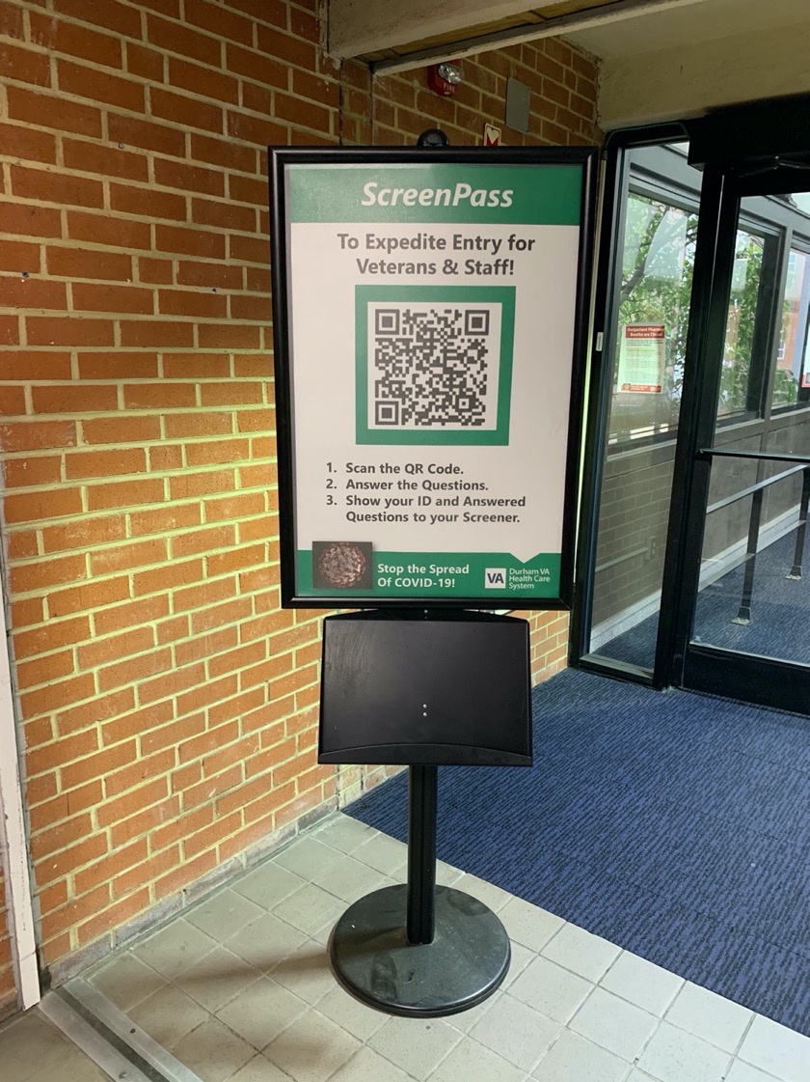
Day 5: Tuesday, May 12 Third field visit
Second day of ScreenPass operations
Bright and early at 7:00
Employees told to download QR code reader

Slide 8
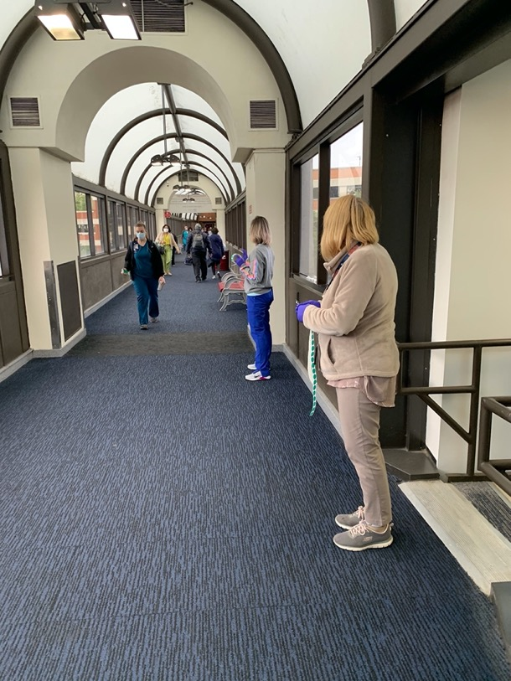
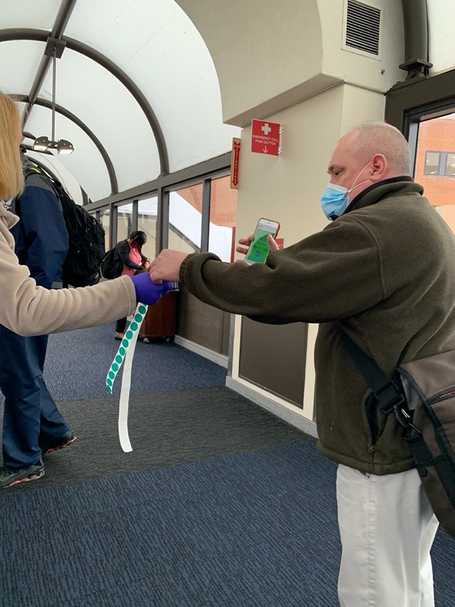
Day 5: Tuesday, May 12 Third field visit, 7-8 am, ~400 employees
Status | Users
Did not use app | 298
Successful with app | 81
Successful with app with additional help | 15
App did not work for them | 6

Slide 9
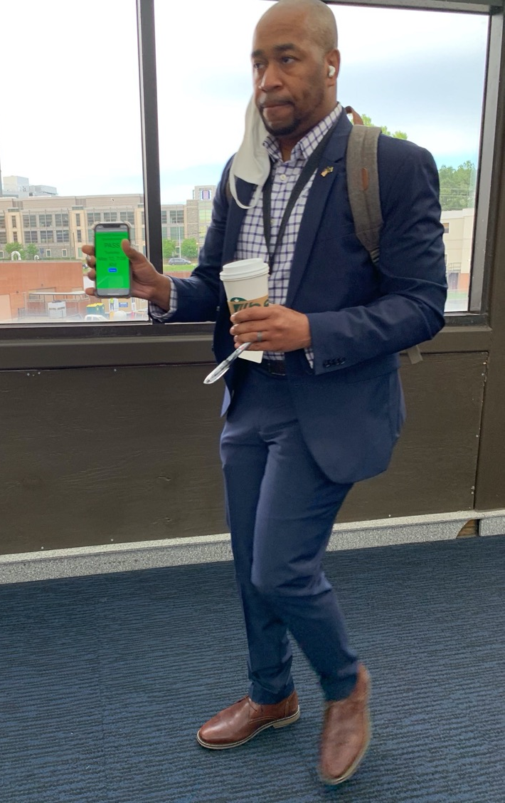
Day 5: Tuesday, May 12 Third field visit
Folks have their hands full
Folks who used the app successfully really liked it
Much faster than in-person questions
QR code reader not 100% reliable

Slide 10
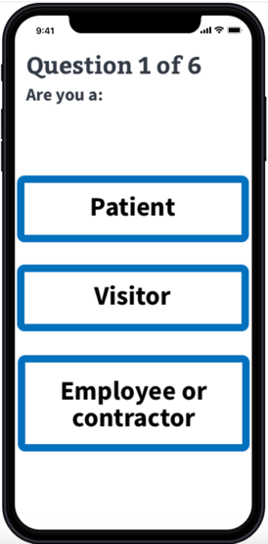
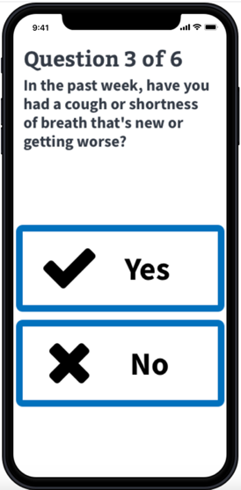
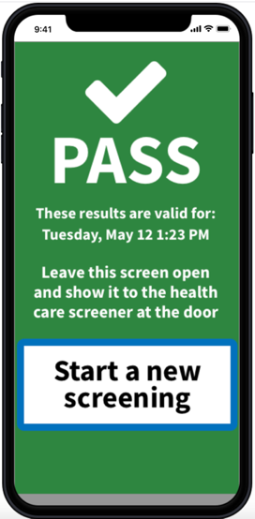
Day 5: Tuesday, May 12 afternoon Back at the computer
Created a clickable prototype
Content expert took over the questions
Developers started coding

Slide 11
Days 6-10: Wednesday, May 13-17 Testing and iteration
Guerilla usability testing via Jeff
Accessibility input
Feedback from everyone
Mike and Michelle continued coding
Jeff planned a usability test on Monday…but would we use the prototype or real code???

Slide 12
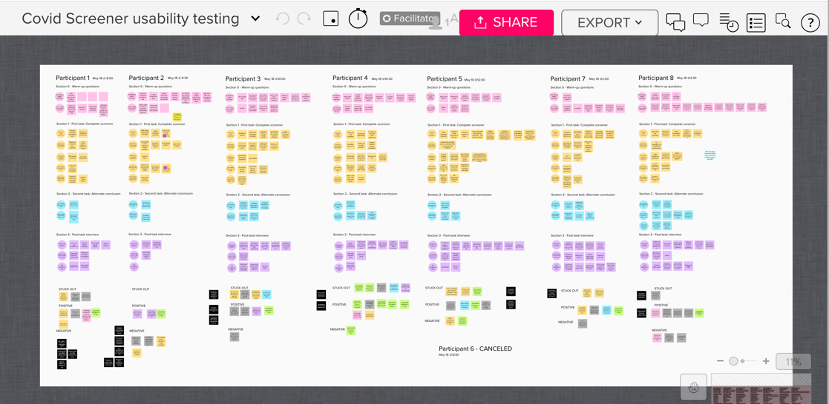
Day 11: Monday May 18 Usability testing with Vets, real code, on phones
“If you’re doing this from your vehicle, then you are at a safe distance from staff and others.”
“Less stress having it in this format.”
“Straight and to the point. Very easy to answer these questions.”

Slide 13
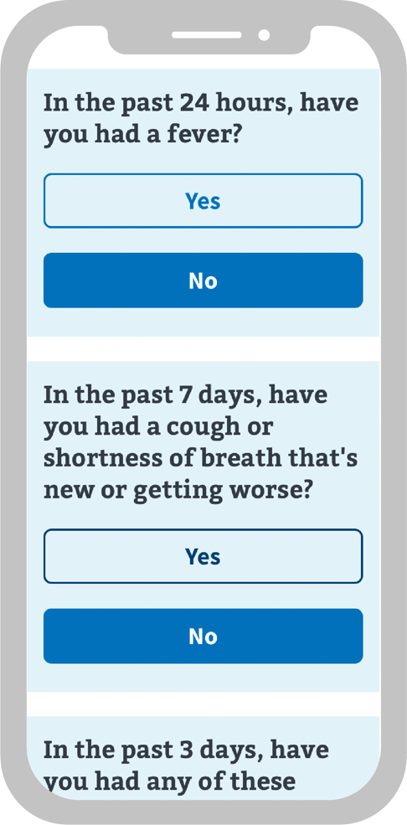
Day 12: Wednesday, May 20 Shipped to staging!
Try it for yourself now!
Text screen to 53079

Slide 14
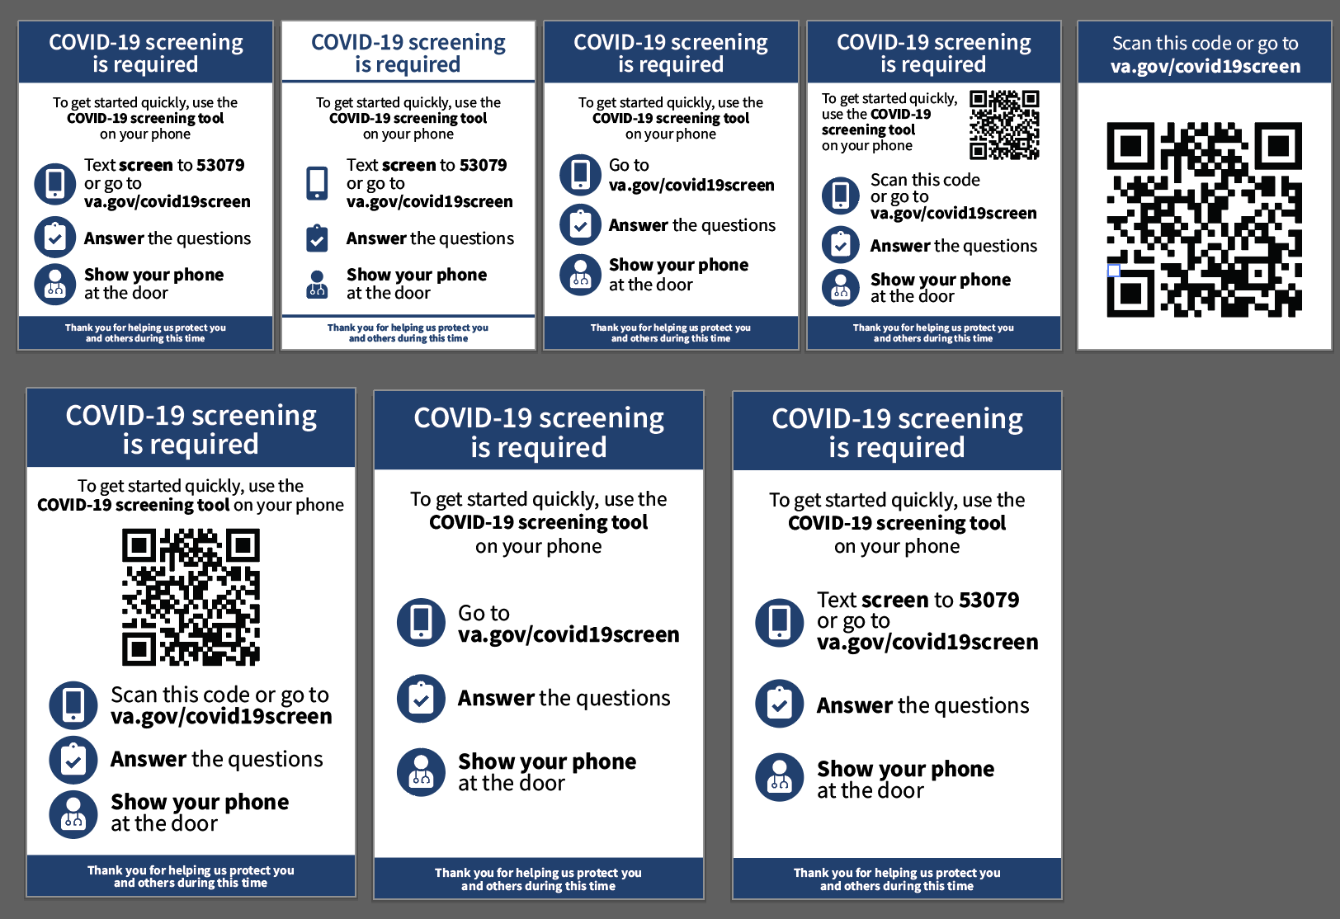
Next steps: Rollout and service design
“Quick and efficient”
“Love to implement ASAP”
“Kudos to you and your team for getting this stood up so rapidly”
Posters and flyers
Custom questions?
En español?

Slide 15
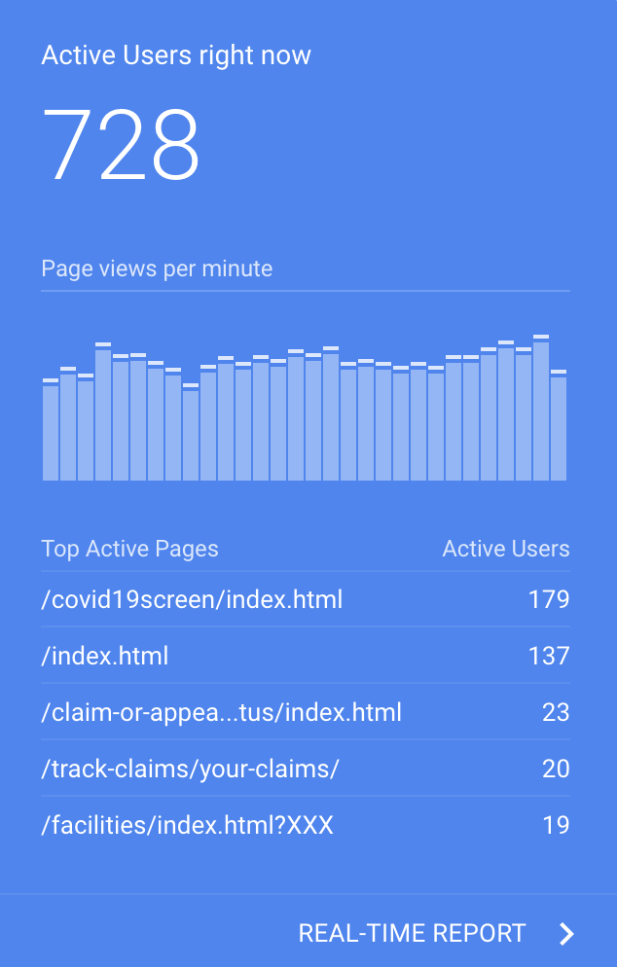
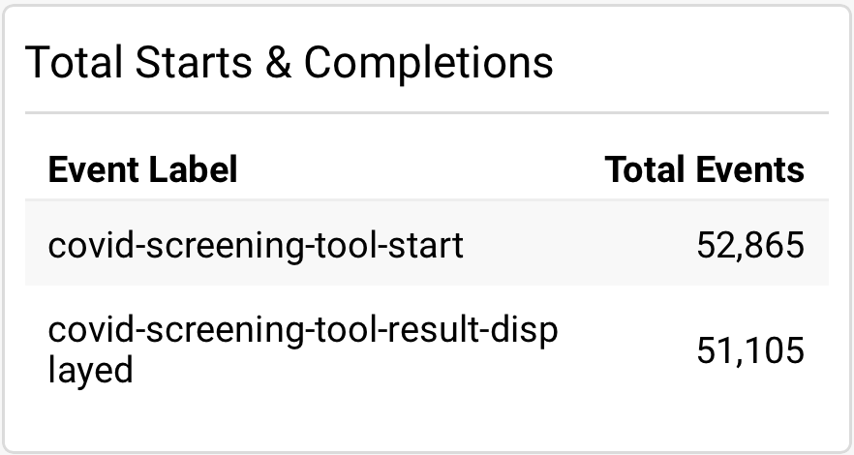
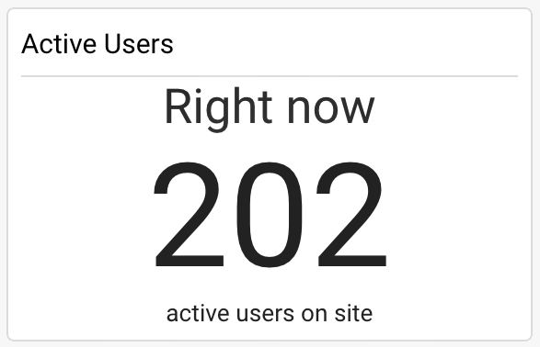
Google analytics

Slide 16
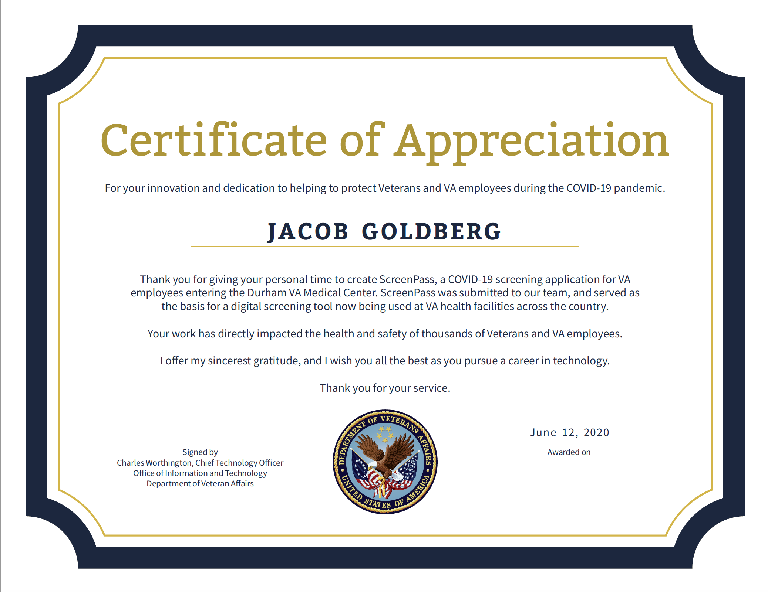
Credit where credit is due

Slide 17
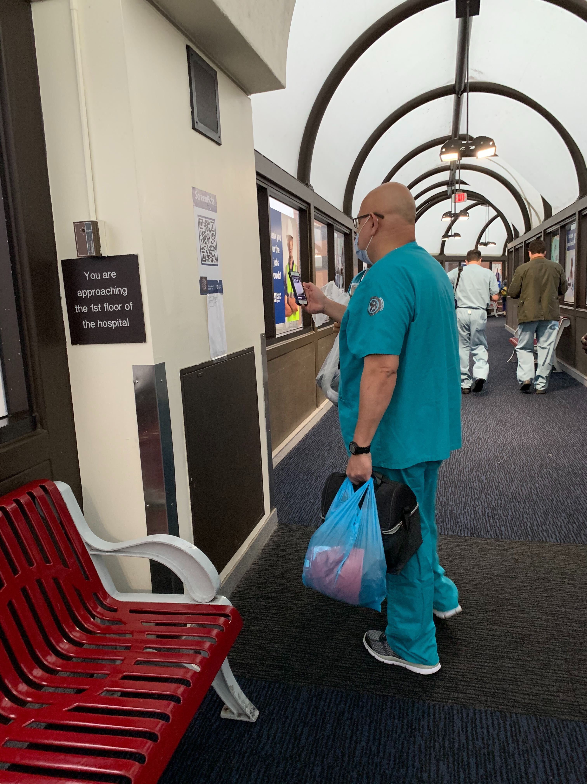
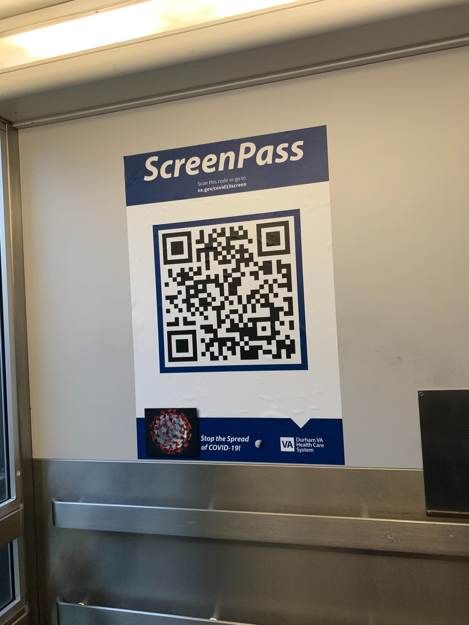
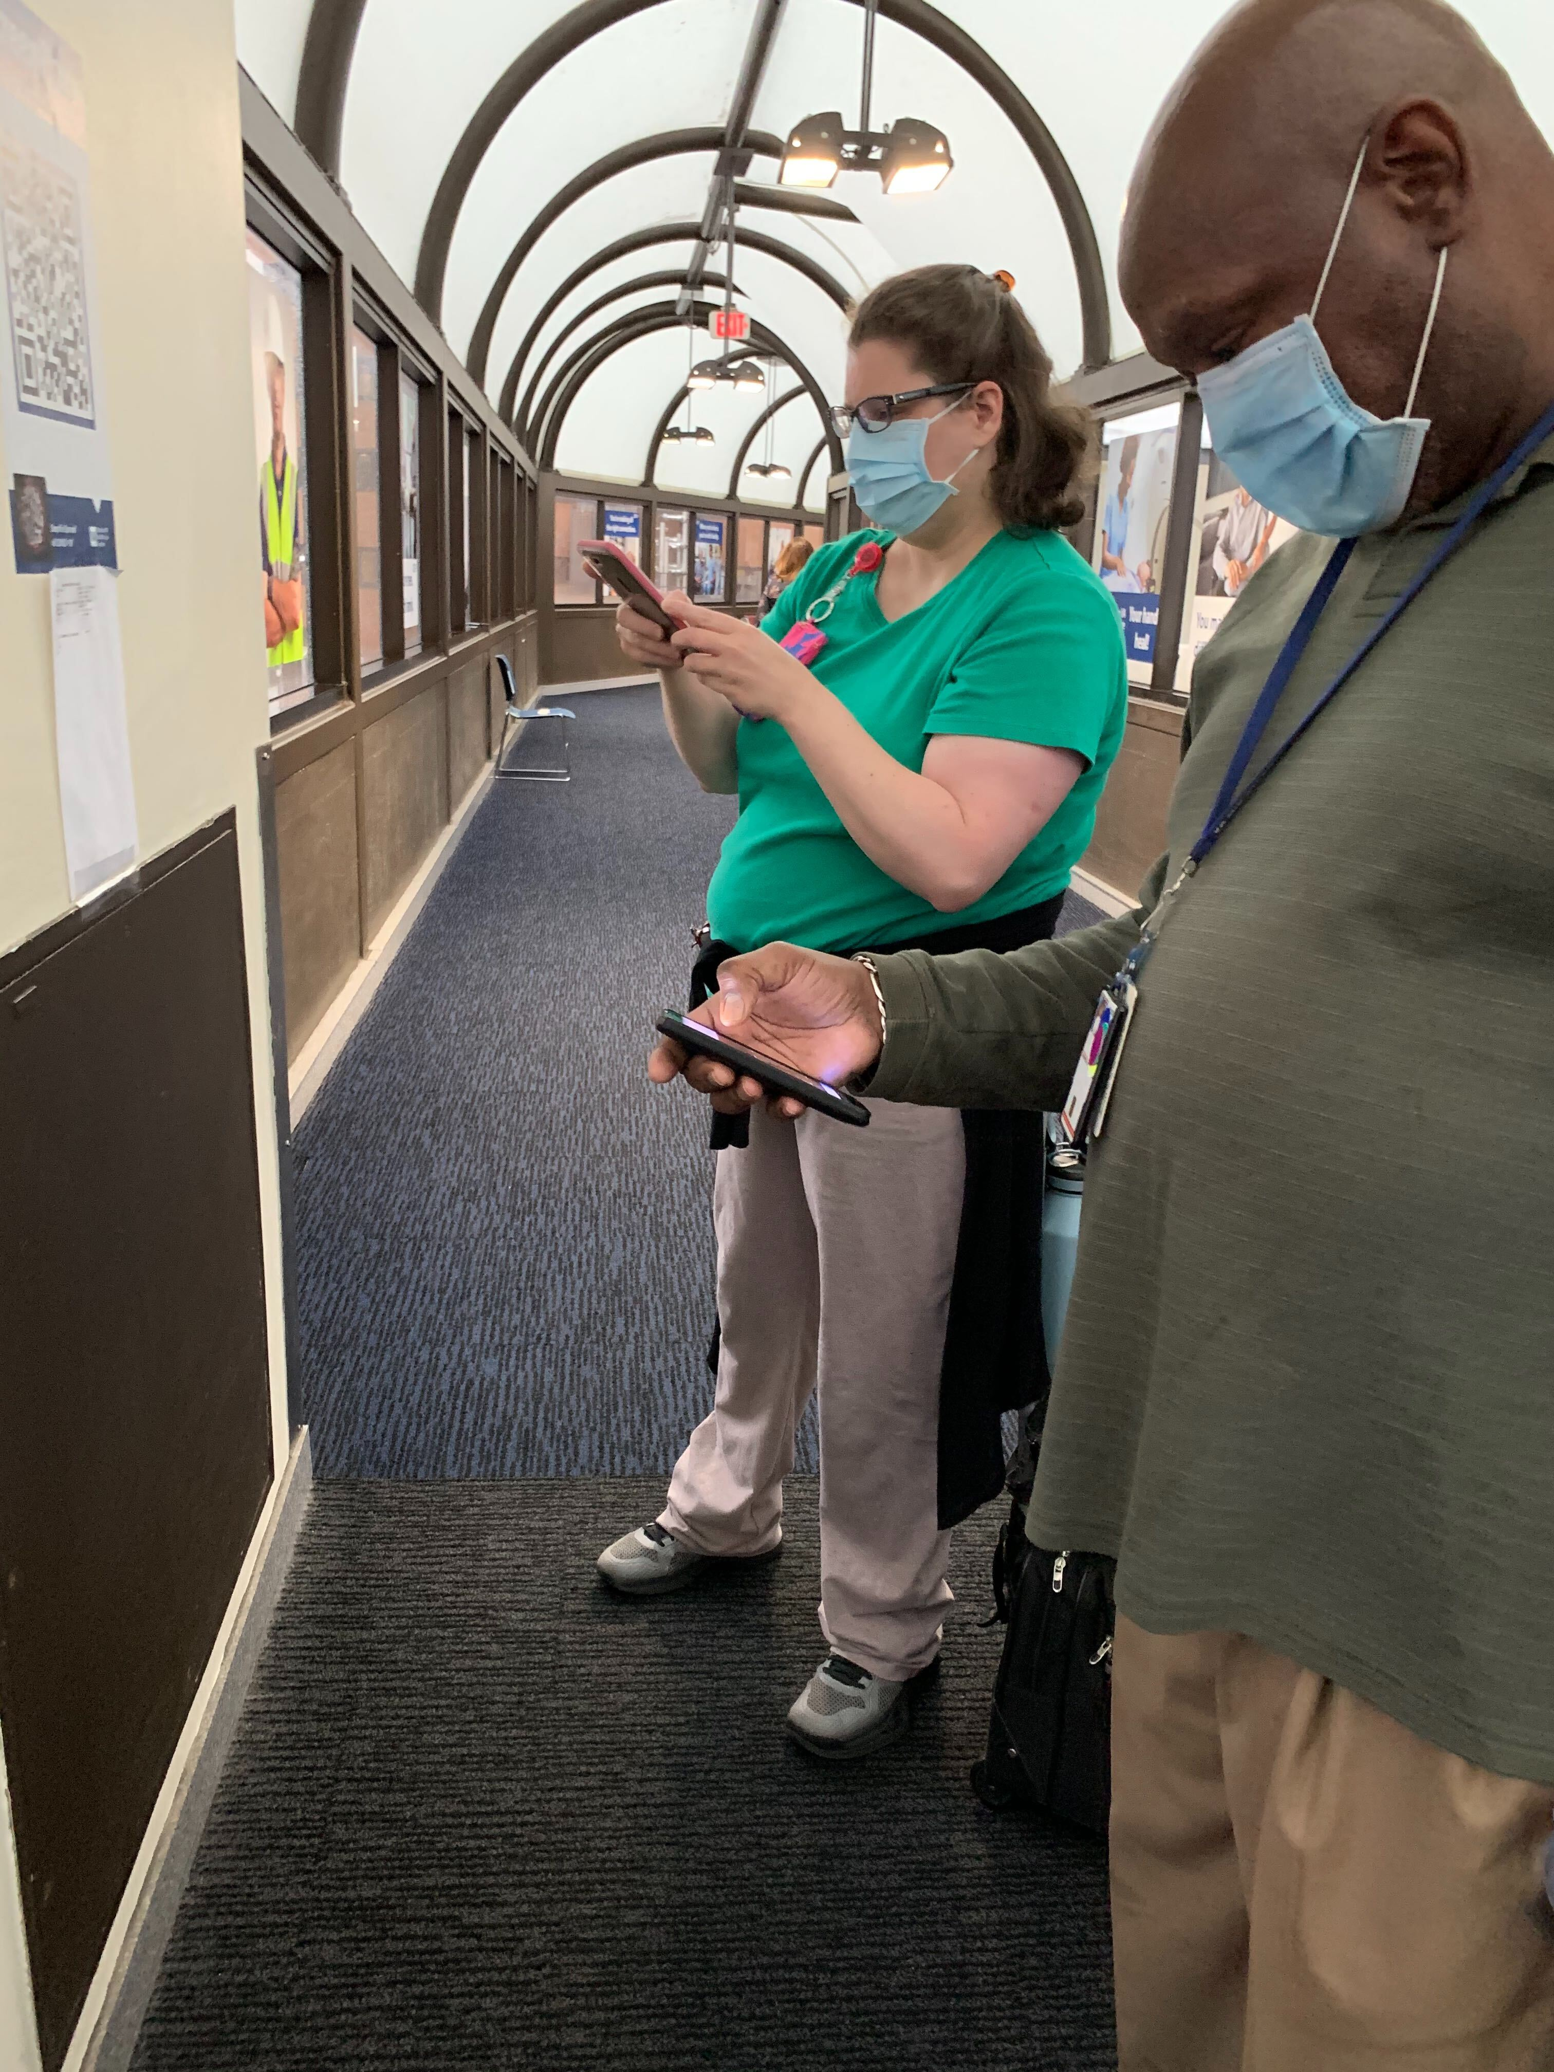

Slide 18
